Slide 1
Terro’s Real Estate Agency
Nithin kumar v

Slide 2
CASE STUDY
As an auditor for Terro's Real Estate Agency, my task is to collect and analyze data on the 506 houses in the city of Boston. This involves gathering information on various features of the properties as well as the surrounding geography, in order to accurately calculate the average price of houses in the area.
Some of the relevant features to consider when collecting data on the houses include:
Number of rooms (Avg_room)
Percentage of lower status of the population (Lstat)
Nitric oxides concentration (NOX)
Average number of bedrooms per dwelling (Avg_bedroom)
Distance to employment centers (Distance)
Property tax rate (Tax)
Pupil-teacher ratio by town (Ptratio)

Slide 3
Situation:
Predicting price of real estate is challenging and it depends on a number of variables like sequence area and neibourhood. we have to predict housing prices in business area.
Task:
Understand key characteristics and attributes of properties and its neighbourhood so that we can predict the price of a property

Slide 4
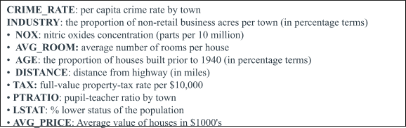
action

Slide 5
The total number of observations in the dataset is 506
The variable "Avg_room" is highly peaked, while "Indus" has low peakedness.
The variables "Lstat" and "Avg_room" are leptokurtic, while "Age", "Indus", "NOX", "Distance", "Tax", and "Ptratio" are platykurtic.
"Avg_price" has high skewness, while "Ptratio" has low skewness.
"Indus", "NOX", "Distance", "Tax", "Avg_room", "Lstat", and "Avg_price" are right-tailed, while "Age" and "Ptratio" are left-tailed.
The variable "Tax" has the maximum mean.

Slide 6
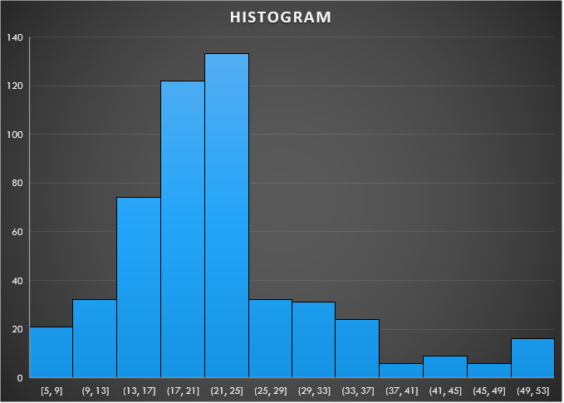
The histogram has high peakedness, which suggests it is leptokurtic (i.e., has a high degree of kurtosis).
The skewness of the histogram is positive, indicating that the distribution is right-tailed.
The average value of the dataset is 22.5.
The most frequently occurring value in the dataset falls within the range of 20-25.

Slide 7
COVARIANCE MATRIX FOR VARIABLES
Some variables have strong positive and negative relationship with each other .
We know that if x value increases and y value decreases then covariance will be negative
The product of xi-means and yi-means can be near zero when one or both are zero.In this case there will no relationship.
Coavariance helps us to find the relationship between two variables.

Slide 8
TOP 3 POSITIVELY AND NEGATIVELY CORRELATED VARIABLES
Top 3 positivly Correlated
Age and Nox
Indus and Nox
Distance and Tax
Top 3 Negatively Correlated
Ptratio and Avg_price
Avg_Room and Lstat
Lstat and Avg_price

Slide 9
REGRESSION MODEL FOR lstaT VS. AVG. PRICE ; Is LSTAT VARIABLE SIGNIFICANT?
Here we have build regression model for LSTAT and AVG. PRICE and we get output from the model with respect to coefficient value , Intercept and residual plot . So, the coefficient of independent value i.e. -0.95 which states that if the independent variable increase the resulting variable shall decrease as the sign here is negative . The intercept here we have is 34.55 which means the intercept shall cut and through Y-axis at the said point . Residual plot plotted for this model it can be found that it is distributed over X-axis ,which shows that our model is fit . For signifying the LSTAT variable we shall look for the p value of the model i.e. 5.0811E-88 which is very less than 0.05 making it very much significant for regression model.

Slide 10
Model for LSTAT,AVG. ROOM AND AVG. PRICE
Given, we have room(x1)=7 LSTAT(x2)=20 ; to check $30000 Overcharged/Undercharged.
Regression Equation:- Y=5.09478798433655*(x1)-1.35827281187456-0.642358334244129*(x2).
After putting values we get Y=$21458 which is <$30000 hence it is Overcharging.

Slide 11
Model better than Previous model in terms of adjusted r square
Adjusted R Square help us compare regression models with differing numbers of independent variables . Adj. R square value used only when we have more that two variables or multiple regression model. And when we have multiple independent variable in our process the R square value inflates thus we have use Adj. R square value for the inflation to be prevented while performing multiple regression. The adj. R square value of model of previous model is less than this model. Value of adj.R square previous is 0.54 and Value of adj. R square of this is 0.63. LSTAT is only variable in previous whose p value =<0.05 yet in this model we have multiple regression model having two independent variable LSTAT and Avg. Room both significant p=<0.05 hence despite adding the Avg. room variable we got output more than single regression model. Hence we can conclude that the performance of this model is more than previous model.

Slide 12
REGRESSION MODEL WITH AVG. PRICE DEPENDENT AND ALL OTHER VARIABLE INDEPENDENT IN TERMS OF ADJ. R SQ., COEFF.,& INTERCEPT
In the above question we have taken Avg price as dependent variable and rest all as independent variable.Now, we can easily see that the adj. R square is nearly equal to 1 which indicate that our model is fit. The model shall inflate if we keep adding insignificant amount of variables in our model then the adj, r square shall decrease giving output more near to 0.The significance of the variables depends on P-value which shall remain less than 0.05(<0.05) to signify any variable in our question only crime rate has value more than 0.05 that is this variable shall be rejected to make the model more fit, on the other hand LSTAT has lowest value among all which why it is most significant of all.

Slide 13
The coefficient play vital role while getting dependent variable value through independent variable value in the above example we can see from above example that Crime rate,Age,Industry,Distance and Avg. Room are coefficient with positive sign whereas coefficients like NOX,Tax,Ptratio and LSTAT have negative sign coefficient therefore it can be observed that whichever coefficient will have positive coefficient's independent variable increases the value of of dependent variable i.e. AVG. Price increases whereas if the coefficient of negatively independent variable increases the value of or depend variable i.e. AVG. Price decreases.
The intercept (often labelled as constant) is the point where the function crosses the y-axis. In some analysis, the regression model only becomes significant when we remove the intercept, and the regression line reduces to Y = bX + error. model only becomes significant when we remove the intercept, and the regression line reduces to Y = bX + error. Here the Intercept Value is 29.24 , means at 29.24 value in Y axis , the regression line is intercepting

Slide 14
model WITH ONLY SIGNIFICANT Variables vs. avg. price(from previous model).
Model Equation :-Y=0.03X1+0.13X2-10.27X3+0.26X4-0.014X5-1.07X6+4.125X7- 0.60X7+29.428
Value of adj. R square in previous model :- 0.6882986
Value of adj. R square in present model :-0.688683682
In present model the we have consider every variable except crime rate (insignificant variable) and it is showing more adj. R square value than the previous model hence this model shall perform better.

Slide 15
Sorting variable coefficient in ascending order
NOX -10.27270508
PTRATIO -1.071702473
LSTAT -0.605159282
TAX -0.014452345
AGE 0.03293496
INDUS 0.130710007
DISTANCE 0.261506423
AVG_ROOM 4.125468959

